Slide 1
3u3 CubeSat Instrument Response Simulations
By: Daniel Abel
04/08/2024

Slide 2
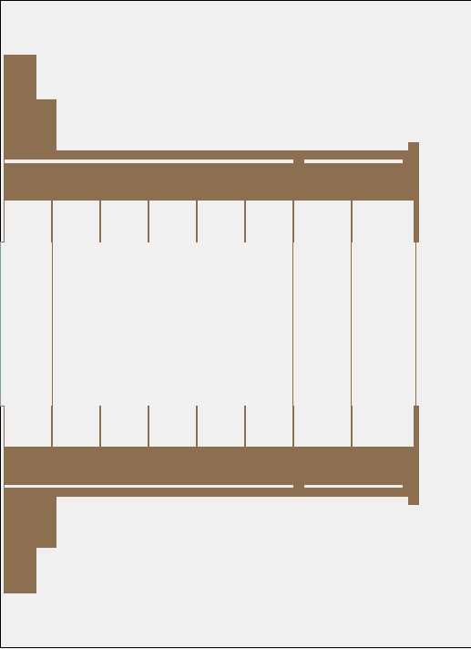
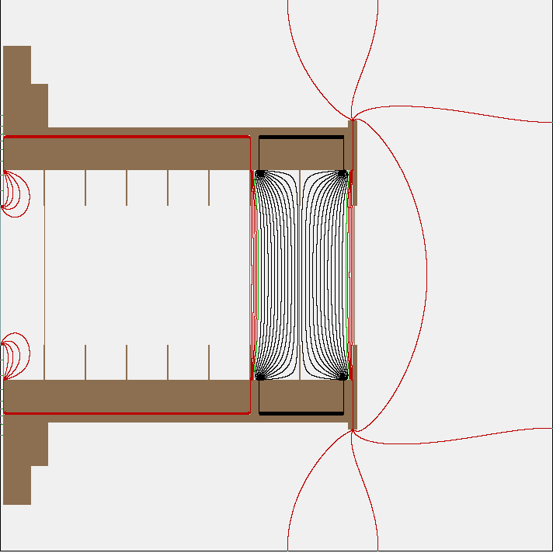
New 2D layout with screens implemented
Image on the left shows new 2D layout
Also shows the 4 new screens added in the model
2 collimator
1 front plate
1 selection screen
Collimator and front plate are electrically connected
Image on the right shows field lines
This example shows
SS = -25V
Col + FP = +5V
Anode = +5V
Everything else set to 0V
Red positive volt= [1:1:5]
Black negative volt = [-2:-2:-24]
Green = 0V

Slide 3
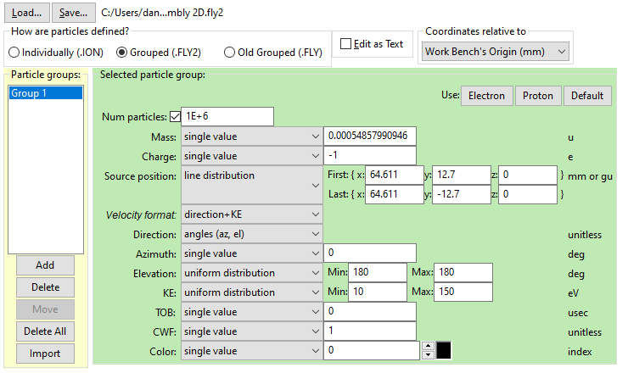
Starting Population Definition for 0deg centerline

Slide 4
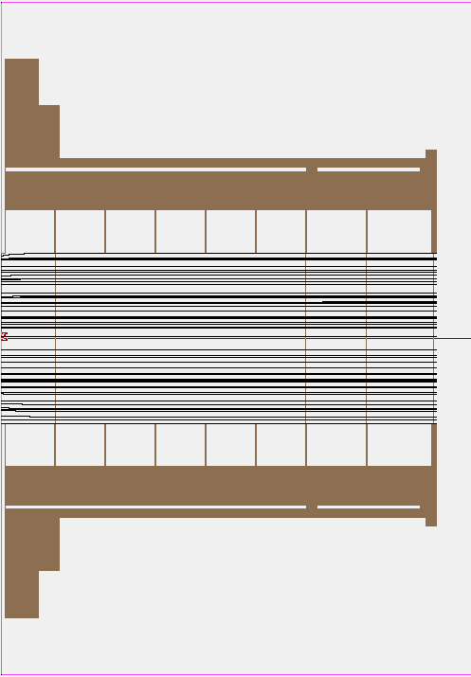
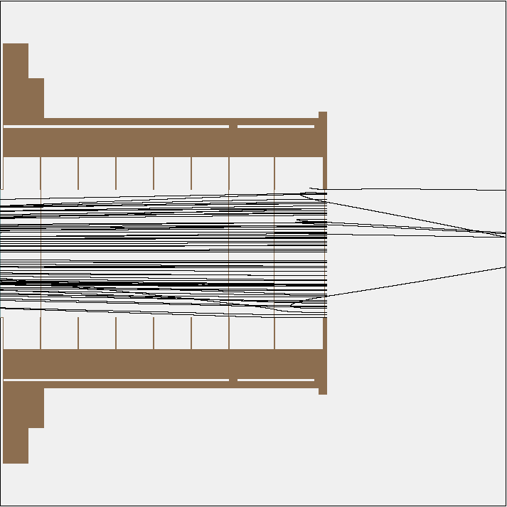
0deg pop trajectory examples
Left image shows trajectories for the 0deg angled pop
Anode =+5V
Right image shows trajectories for the 0deg angled pop
Anode =+5V
SS = -25V
Col + FP = +5V

Slide 5
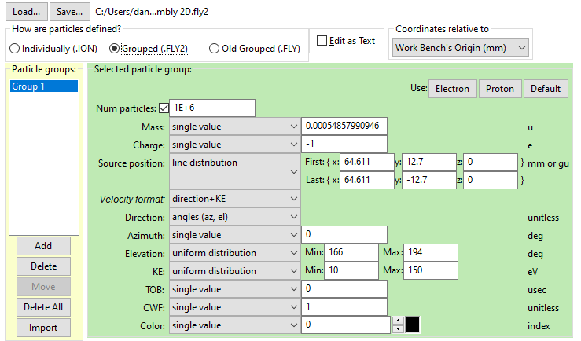
Starting Population Definition for 14deg centerline

Slide 6
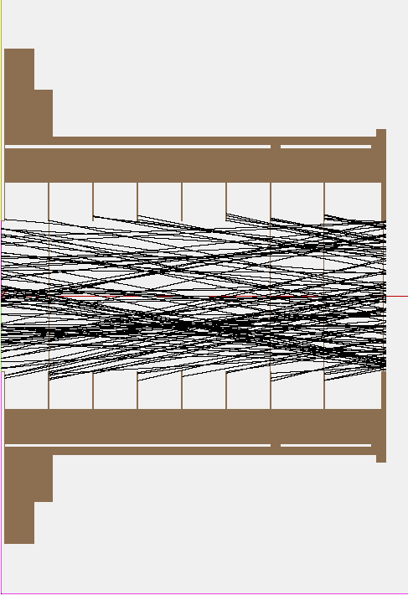
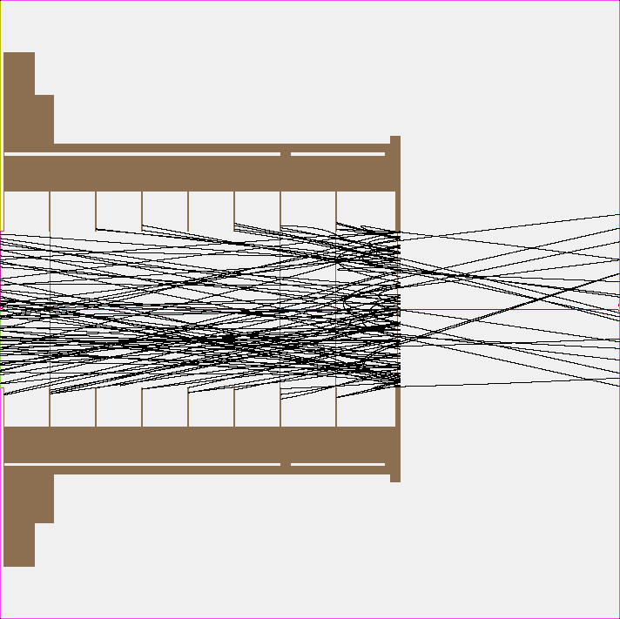
14deg pop trajectory examples
Left image shows trajectories for the 0deg angled pop
Anode =+5V
Right image shows trajectories for the 0deg angled pop
Anode =+5V
SS = -25V
Col + FP = +5V

Slide 7
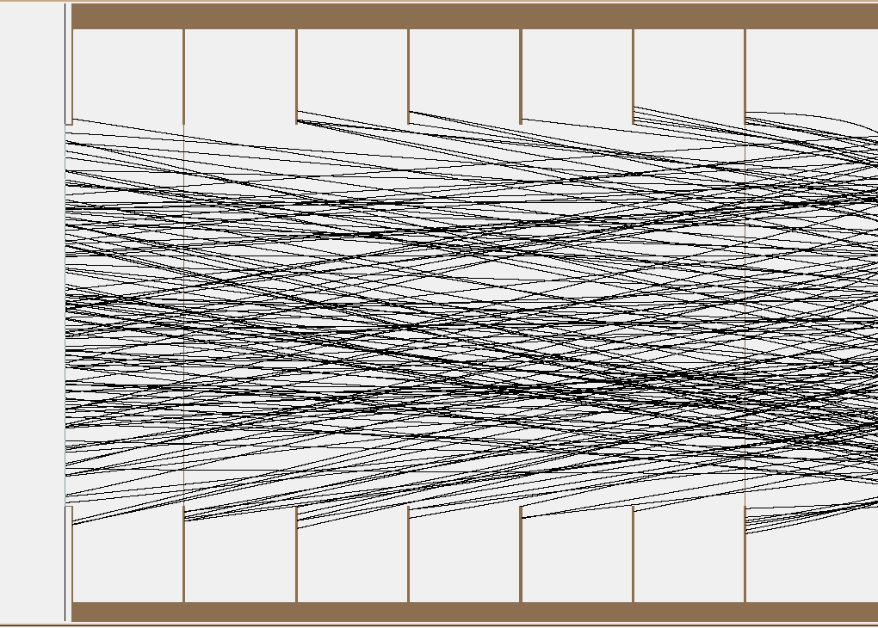
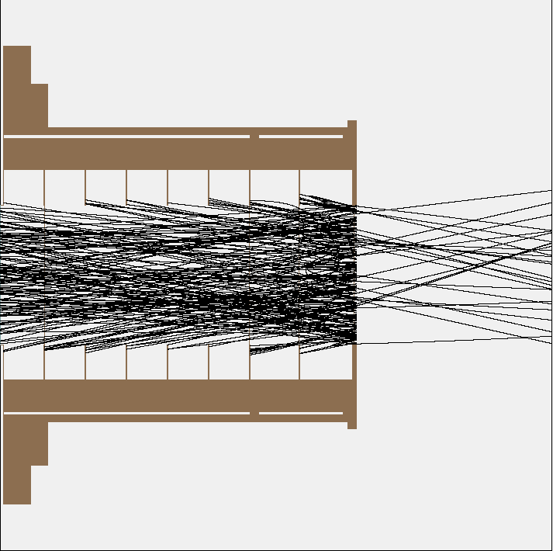
How are particles counted?
Red circles show where particles did not impact the anode face and are not counted as “good” impacts
Green circles show where particles did impact the anode face and are added to the counts shown in the graphs

Slide 8
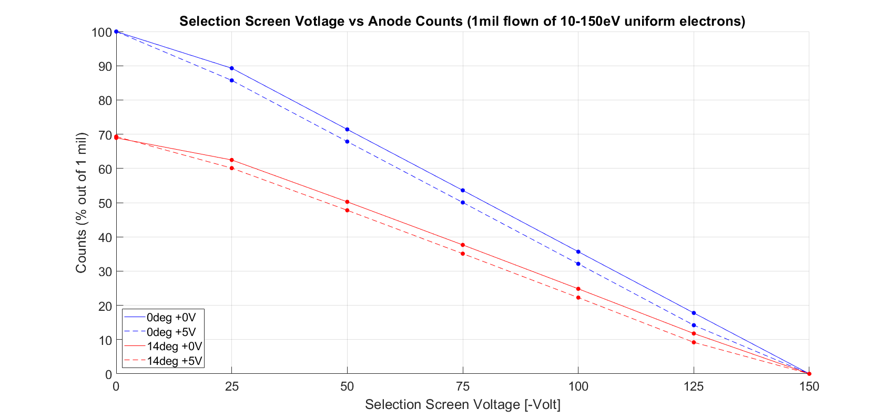
Results for 0deg from instrument centerline (with either 0V or +5V collimator and front plate)

Slide 9
Results Cont. for 0deg and 14 deg populations with 0 or +5V collimator and front plate
Counts as percentages compared to the 1mil population
Counts are registered only when they impact the anode face
SS Voltage | 0 deg, 0V Col+FP | 0 deg, 5V Col+FP | 14 deg, 0V Col+FP | 14 deg, 5V Col+FP
0V | 99.9814% | 99.9933% | 68.9196% | 69.3022%
-25V | 89.2728% | 85.7158% | 62.4718% | 60.0877%
-50V | 71.3962% | 67.8474% | 50.2386% | 47.7653%
-75V | 53.5929% | 50.0486% | 37.6519% | 35.0954%
-100V | 35.6725% | 32.1305% | 24.8266% | 22.2643%
-125V | 17.7761% | 14.1932% | 11.7764% | 9.1915%
-150V | 0% | 0% | 0% | 0%

